Slide 1
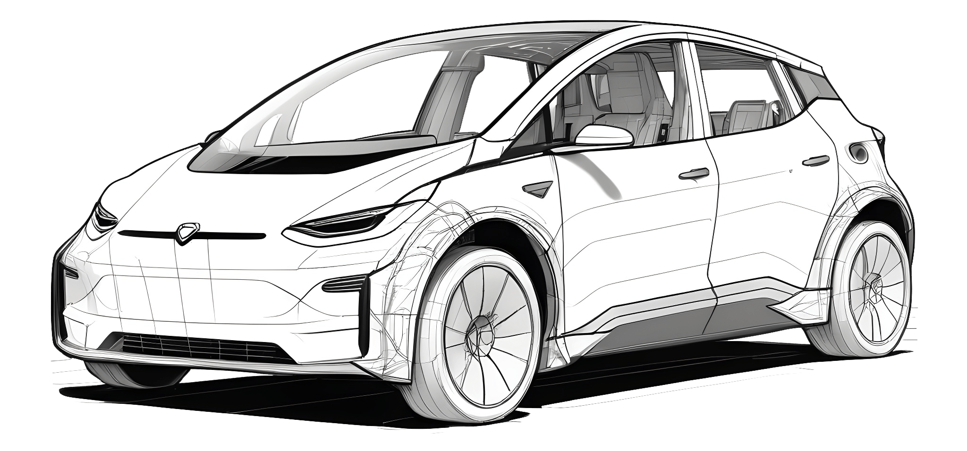
Predicting Prices of Second-Hand Cars
Aisyah Amatul Ghina
Flory
Paola Garay
Tiago Pedro

Slide 2
Project Overview
In the rapidly growing used car market, accurately predicting the price of second-hand vehicles is crucial for both buyers and sellers.
Estimating the right price based on its various attributes can help buyers make informed decisions, while sellers can set competitive prices.
Objective | to develop a machine learning model that can predict the price of used cars based on multiple attributes
Potential Impact | Standardize price definition for second-hand cars Better readability of prices for consumers
Notes:
In the rapidly growing used car market, accurately predicting the price of second-hand vehicles is crucial for both buyers and sellers.
Prices of used cars are influenced by multiple factors such as brand, model, mileage, age, engine capacity, fuel type, and more.
Estimating the right price based its various attributes can help buyers make informed decisions, while sellers can set competitive prices.

Slide 3
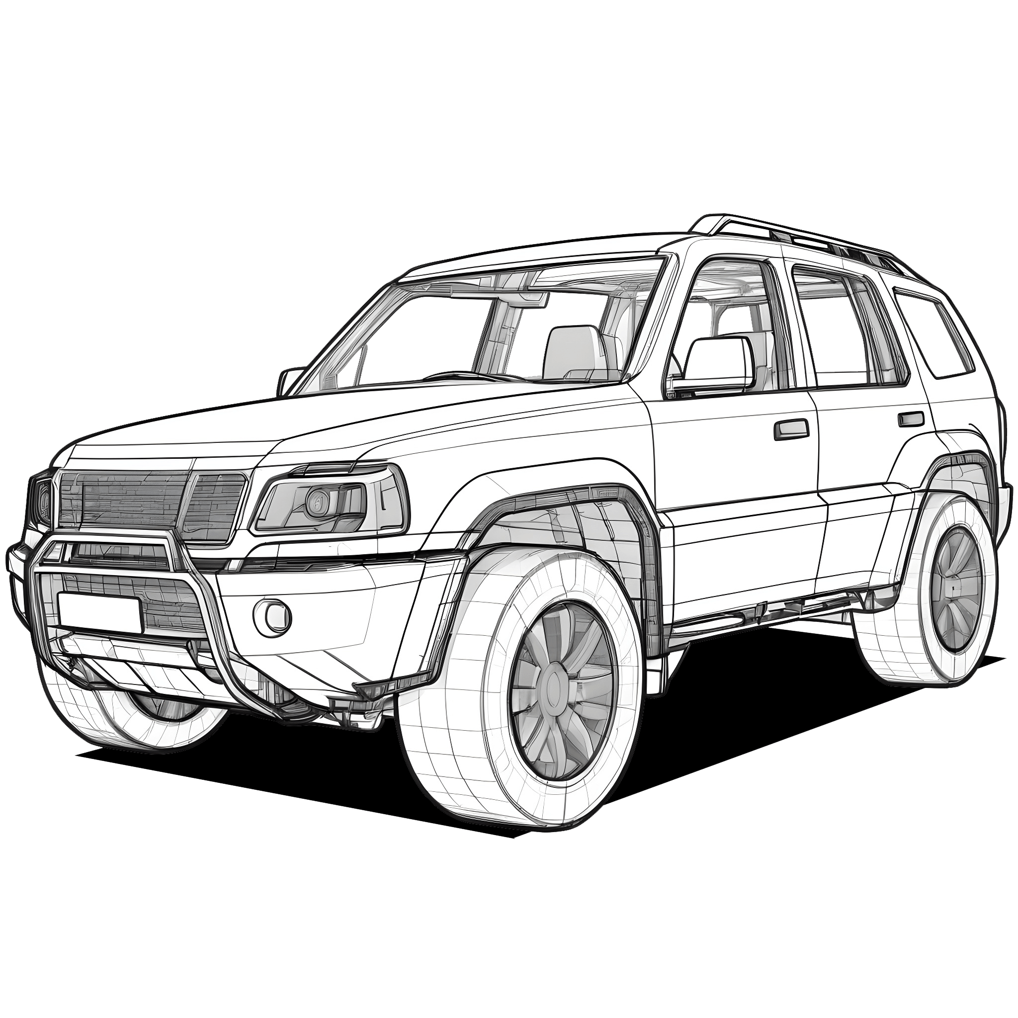
Data Overview
Target
Features
Price
Brand Accident
Model Clean_title
Model year Transmission
Milage External color
Fuel type Internal color
Engine
Shape
Source
(187765, 13)
Kaggle

Slide 4
Data Selection and Preparation
Understand every column
Fill in null and unclean data
Create functions for a clean dataset
Researched technical details about cars
Took some decisions based on cars characteristics’ logic
Every cleaning functions have been sent to a separate file to scale the cleaning process for all of us
Notes:
Describe the dataset(s) used, including sources and any key characteristics.
Highlight the data cleaning and preprocessing steps undertaken to prepare the data for modeling.

Slide 5
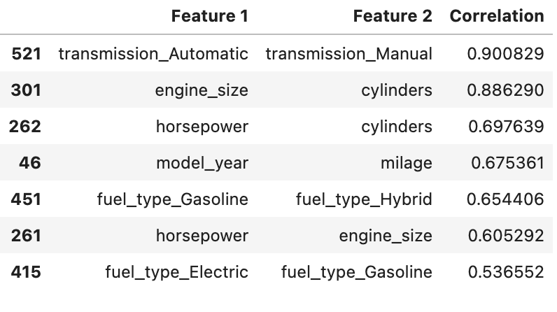
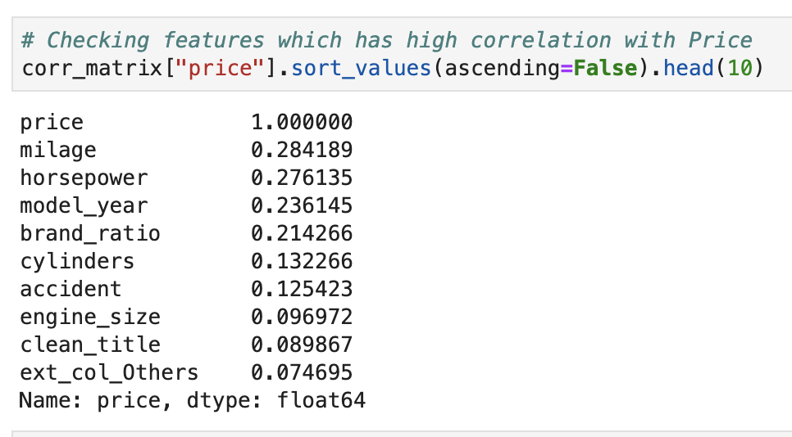
Feature Engineering
Feature Selection
Normalization
One Hot Encoding
Low correlation between features
High correlation with target

Slide 6
Model Building and Evaluation
 |  | TRAIN |  |  | TEST
Model | Parameters | MAE | RMSE | R² | MAE | RMSE | R²
KNN Regression | K=10 | 16183.32 | 58457.25 | 0.25 | 17628.06 | 65764.58 | 0.08
Linear Regression |  | 19194.52 | 63131.62 | 0.13 | 19068.93 | 63974.5 | 0.13
Decision Trees | Max depth: 5 | 17033.61 | 62159.81 | 0.15 | 16933.76 | 63331.70 | 0.14
Bagging and Pasting | Max depth: 5 | 17197.40 | 62313.73 | 0.15 | 17209.07 | 63574.70 | 0.14
Random Forest | Max depth: 5 | 16648.39 | 61360.77 | 0.17 | 16592.94 | 63239.19 | 0.15
Adaptive Boosting | Max depth: 5 | 333311.40 | 506211.80 | -55.21 | 332764.11 | 507162.79 | -53.98
Gradient Boosting | Max depth: 5 | 15782.15 | 56643.92 | 0.30 | 16320.64 | 63768.62 | 0.13
Notes:
Based on the evaluation, Gradient Boosting proved to be the most effective model, balancing predictive accuracy and model complexity. It offers the best performance on unseen data, while simpler models like Linear Regression and KNN failed to capture the underlying patterns in the data.

Slide 7
Hyperparameter Tuning Results
Random Forest (Best Params: Max Depth=5, Max Leaf Nodes=100):
Test MAE: 16,570.11
Test RMSE: 63,119.22
Test R²: 0.15
Gradient Boosting:
Test MAE: 16,320.64
Test RMSE: 63,768.62
Test R²: 0.13
The hyperparameter tuning, slightly improved the prediction accuracy (achieving a MAE of 16,570.11), Random Forest is selected as the final model
Notes:
While hyperparameter tuning improved Random Forest, Gradient Boosting still offers slightly better MAE and general performance. Random Forest has a slight edge in R² but the differences are minor. Gradient Boosting remains a strong option for minimizing errors.

Slide 8
Key Findings and Insights
Top Features Influencing Price:
  Mileage, Model Year, and Engine Size were consistently the most important features across all models.
  Brand Ratio provided additional value, helping models better distinguish between car brands and their impact on price.
Random Forest: is the best-performing model, after hyperparameter tuning showed slightly higher R² (0.15)
Gradient Boosting: it has the lowest MAE (16,320.64) and competitive R² (0.13), but shows more signs of overfitting.
Notes:
Present the major findings from your model, potentially comparing different models or highlighting the most effective features.
Use visual aids to illustrate these insights clearly and effectively.

Slide 9
Real-World Application and Impact
Practical Application
Used Car Dealerships
Insurance and Financial Services
Impact of the Model
Market Efficiency
Increased Accessibility
Improved Decision-Making
Online Car Marketplaces
Consumers

Slide 10


Challenges
Learnings
Implement highly complex notions right after class
Selecting the right model
Merging our local work
Correlation between features and target are highly impacted by our data-cleaning choices
Hard to create a good model right away

Slide 11
Future Work and Improvements
Improve Feature Engineering
  Transform categorical features, like external color, into ordinal variables based on their impact on price to improve model performance.
Incorporation of External Data Sources
  Consumer preferences and sentiment analysis
  Macroeconomic Data: Car prices are influenced by macroeconomic factors such as interest rates, inflation, and fuel prices

Slide 12
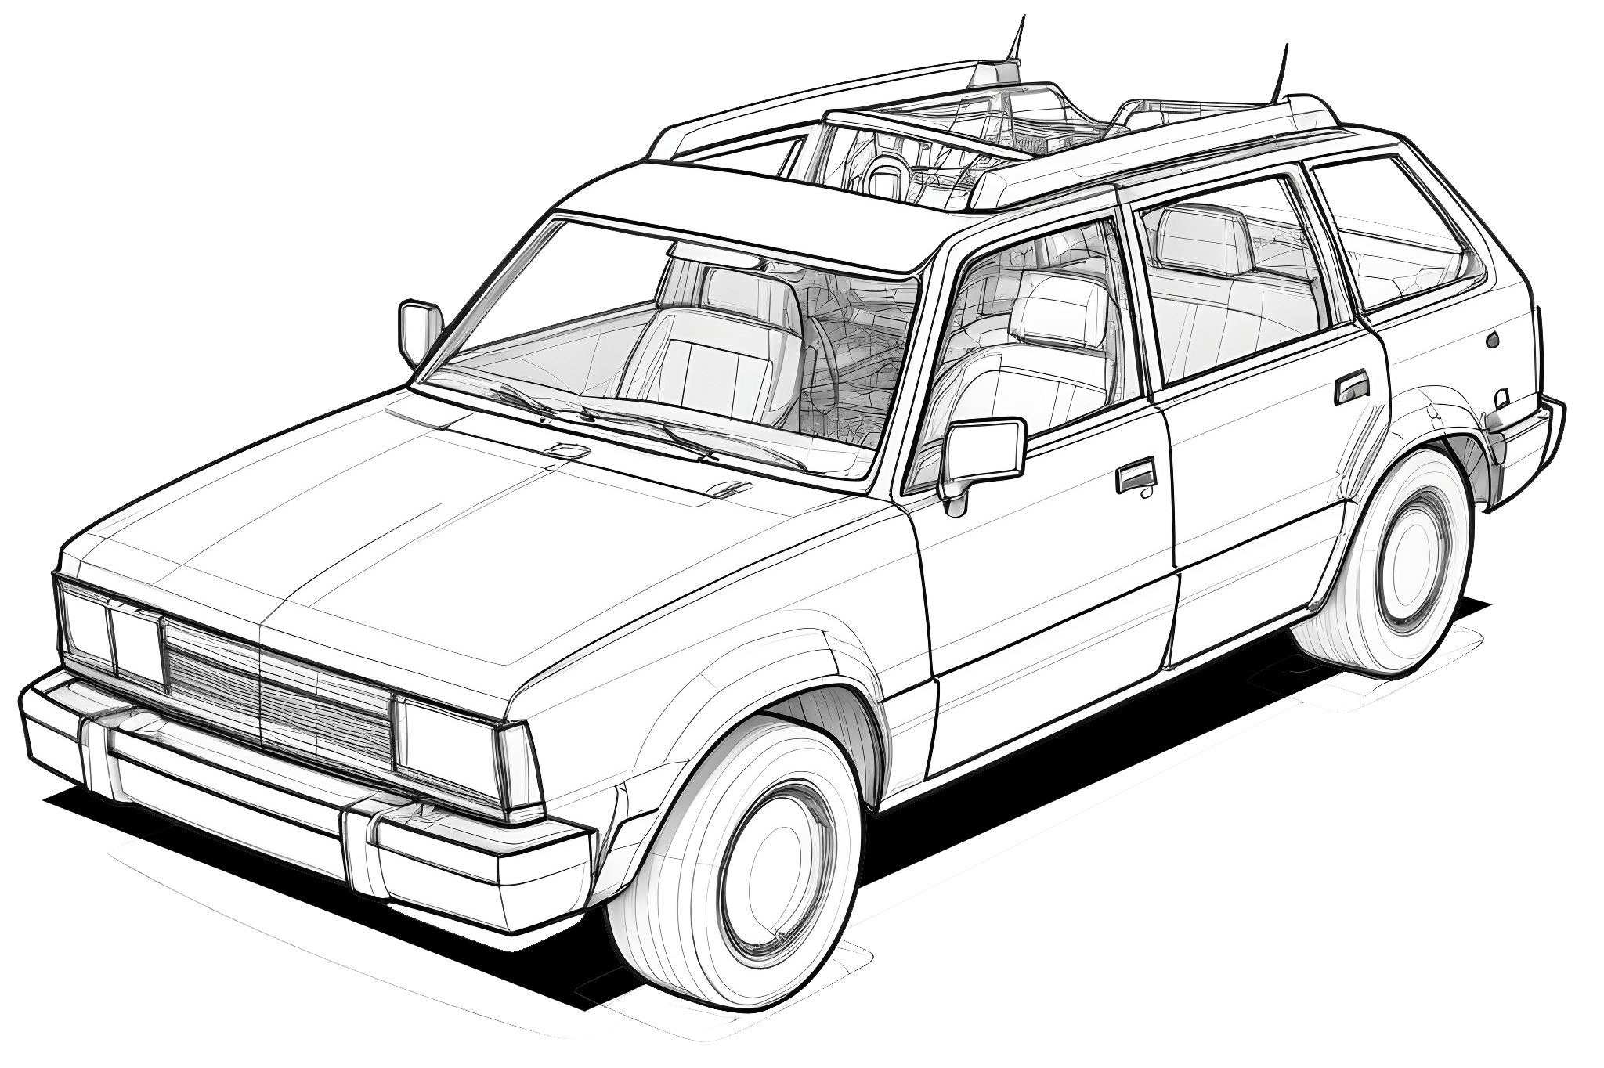
Thanks!
Aisyah Amatul Ghina
Flory
Paola Garay
Tiago Pedro

